Slide 1

Managerial Readings
Dr. Salem A. Al-Jundi
salem.aljundi@kunoozu.edu.iq
Al-Kunooz University College
2024

Slide 2
Content
Management
A successful Manager, Alex Thompson
Planning
Planning for Horizon Innovations
Organizing
Mr. Playwell, the owner of Playtopia
Leading
Miss Harmony, the leader of Sweet Bliss
Controlling
A bakery called Harmony Delights

Slide 3
MODE OF ASSESSMENTS
Components | Marks
Semester Exam | 30
Assignment | 10
Absenteeism & Participation | 10
Final Exam | 50

Slide 4
Semester and Final Exams
Semester Exam | Final Exam | Types of Questions
√ | √ | Multiple-choice questions
√ | √ | True / False questions
√ | √ | Match the terms to their explanations
 | √ | Fill in the blanks
 | √ | Definitions
 | √ | Short essay questions

Slide 5
How to write your assignment in Managerial Reading?
Go to Salem Al-Jundi’s YouTube channel.
Select one video clip among 49 videos in Microeconomics and Macroeconomics.
Listen and then write an article of one page about the video you selected.
Write your full name and section (morning or evening) in the first line.
Write the video’s title in the second line.
The article should include an introduction, sections, and a conclusion.
Send a PDF file to salem.aljundi@kunoozu.edu.iq, and start your email with your name, section, and the video’s title. Moreover, wait to receive confirmation.
Use Times New Roman as font, 12 as font size, Bold for subtitles, and Line spacing 1.
Name the PDF file with your full name in English.
Avoid similarities with articles of your classmates.

Slide 6
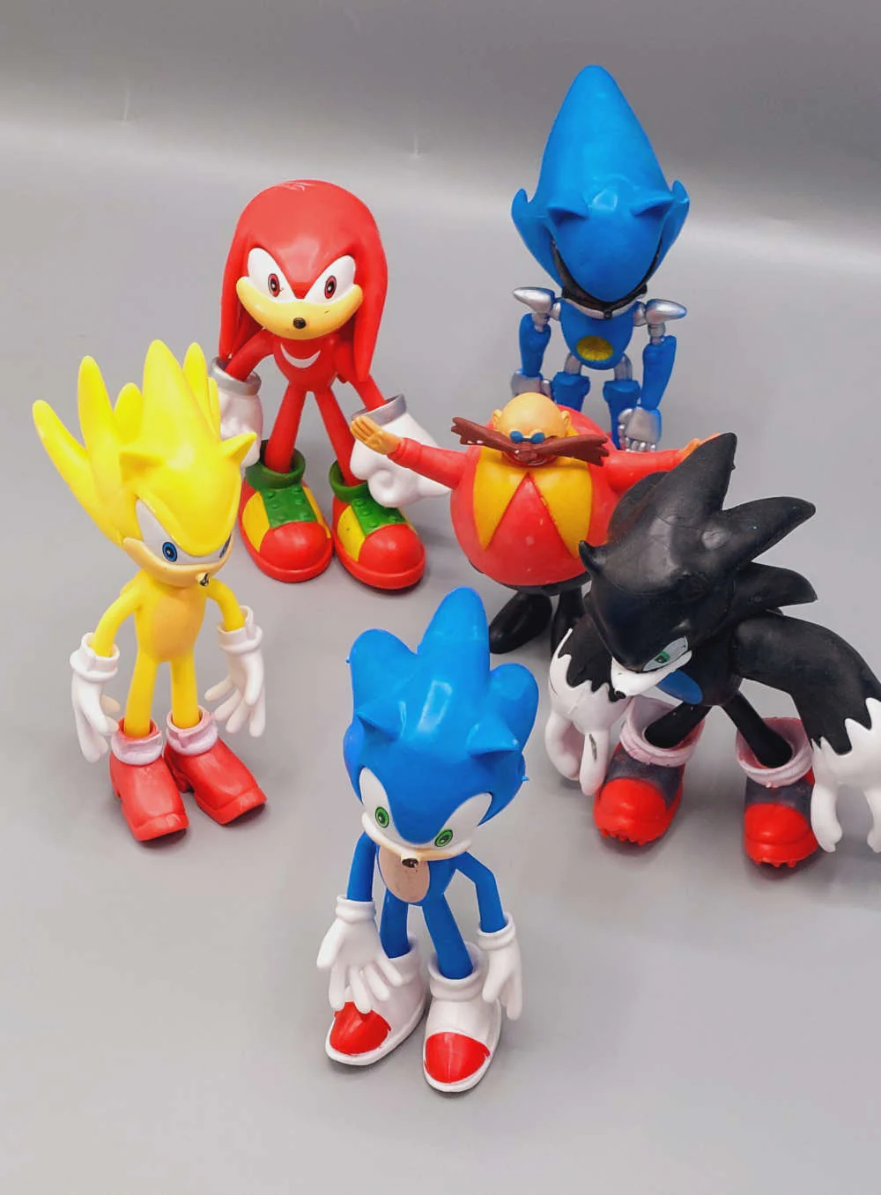
Chapter 6
Mr. Playwell, the owner of Playtopia
Story
True / False Questions

Slide 7
Mr. Playwell, the owner of Playtopia
Read the passage and then answer the questions underneath.
Once upon a time in the busy city of Harmonyburg, there was a fantastic toy factory known as Playtopia. In Playtopia, toys of all shapes and sizes were crafted with love and care to bring joy to children worldwide.

Slide 8
Mr. Playwell, the owner of Playtopia
One sunny day, Mr. Playwell, the friendly owner of Playtopia, decided to organize a special event to launchيطلق their newest toy collection. The challenge was immenseهائل because there were countless toys, each requiring attention to detail and a touch of magic.

Slide 9
Mr. Playwell, the owner of Playtopia
To make this event a success, Mr. Playwell gathered his team of dedicatedالمتفانين toy-makers – a group of elvesالجان, robotsالروبوتات, and teddy bearsدمى الدببة. He knew that organizing their efforts was crucial to ensure that the event would be a magicalخلابة experience for everyone.

Slide 10
Mr. Playwell, the owner of Playtopia
Mr. Playwell called a meeting in the heart of Playtopia and shared his visionرؤية for the event. He explained that each toy had a unique role to play, just like charactersالشخصيات in a story.
The elves would craft the intricate dolls, the robots would assemble the interactive gadgets, and the teddy bears would take charge of the cuddly and soft toys.
يقوم الجان بصناعة الدمى المعقدة، وتقوم الروبوتات بتجميع الأدوات التفاعلية، وتتولى دمى الدببة مسؤولية الألعاب المحبوبة والناعمة.

Slide 11
Mr. Playwell, the owner of Playtopia
To ensure everything ran smoothly, Mr. Playwell created a giantعملاق chart that outlined the tasks for each team. It was like a treasure mapخريطة الكنز guiding them through the adventure of toy-making. The elves oversawأشرف the Doll District, the robots managed the Gadget Groveبستان الادوات, and the teddy bears oversaw the Cuddly Canyonالوادي المحبوب .

Slide 12
Mr. Playwell, the owner of Playtopia
As the teams began their work, Mr. Playwell moved around, offering support and guidance. He was like a captain steering a ship, ensuring that each team was on course and working together harmoniously. If there were any challenges, he helped them find solutions, just like a wise guide leading a group through a magical forestغابة.

Slide 13
Mr. Playwell, the owner of Playtopia
Days passed, and the factory buzzedطنين with activity. The Doll District was filled with beautifully crafted dolls, the Gadget Grove sparkledتألق with interactive gadgets, and the Cuddly Canyon overflowedفاضت with fluffyرقيق teddy bears. Everything was falling into place, just like pieces of a puzzle coming together.

Slide 14
Mr. Playwell, the owner of Playtopia
Finally, the day of the event arrived. Families from Harmonyburg gathered in front of Playtopia, eagerlyبلهفة waiting to see the new toy collection. As the doors opened, the enchantingفاتن display of dolls, gadgets, and teddy bears captured everyone's hearts.

Slide 15
Mr. Playwell, the owner of Playtopia
The event was a tremendousهائل success, and the families left with smiles on their faces and bags full of Playtopia's magical creations. Mr. Playwell thanked his dedicated team for their hard work and organization, emphasizing how everyone's role was essential in making the event a victory.

Slide 16
Mr. Playwell, the owner of Playtopia
From that day forward, Playtopia continued to organize its toy-making adventures, bringing joy and laughterضحك to children all around Harmonyburg. The lesson of teamwork and organization echoedردد in the walls of Playtopia, reminding everyone that when they worked together, they could create magic. And so, in the heart of Harmonyburg, the tale of Playtopia's well-organized toy-making adventures continued, spreading happiness far and wide.

Slide 17
Mark the following statements as true or false.
No. | True | False | Statements
1 |  |  | Mr. Playwell is the owner of Playtopia.
2 |  |  | Playtopia is a bakery.
3 |  |  | The special event was to launch a new book collection.
√
X
X

Slide 18
Mark the following statements as true or false.
No. | True | False | Statements
4 |  |  | The teddy bears oversaw the Gadget Grove. See slide 11
5 |  |  | The teams in Playtopia were elves, robots, and dragonsالتنين .
6 |  |  | The chart created by Mr. Playwell was like a treasure map. See slide 11
X
X
√

Slide 19
Mark the following statements as true or false.
No. | True | False | Statements
7 |  |  | The Doll District was responsible for crafting interactive gadgets.
8 |  |  | The event was not a success; families did not enjoy it.
9 |  |  | Mr. Playwell thanked his team for their hard work and organization.
10 |  |  | The lesson learned was that when they worked together, they could create chaosفوضى.
X
X
√
X

