Slide 1

Managerial Readings
Dr. Salem A. Al-Jundi
salem.aljundi@kunoozu.edu.iq
Al-Kunooze University
2025

Slide 2
Content
Management
A successful Manager, Alex Thompson
Planning
Planning for Horizon Innovations
Organizing
The Success of Bella’s Bakery
Leading
Miss Harmony, the leader of Sweet Bliss
Controlling
A bakery called Harmony Delights

Slide 3
MODE OF ASSESSMENTS
Components | Marks
Assignment 1 | 10
Assignment 2 | 10
Assignment 3 | 10
Assignment 4 | 10
Semester Exam | 10
Final Exam | 50

Slide 4
Semester and Final Exams
Semester Exam | Final Exam | Types of Questions
✓ | ✓ | Multiple-choice questions
✓ | ✓ | True / False questions
✓ | ✓ | Fill in the blanks
 | ✓ | Match the terms to their explanations
 | ✓ | Define the terminologies
 | ✓ | Short essay questions

Slide 5
Assignment 3
1. Search for “How to delegate tasks effectively” at youtube.com
2. Select an appropriate video clip
3. Each pair of students should submit assignment 3.
4. Listen and then write an article of 200±20 words about the video you selected.
5. Write your full name, classmate, and the section (morning or evening) in the first line.
6. Write the video’s title in the second line.
7. Send your answer to salem.aljundi@kunoozu.edu.iq, and start your email with your name, section, and the video’s title. The topic is assignment 3. Moreover, wait to receive confirmation.
8. Avoid similarities with other articles.
9. The first student should only send the email, not the second one.

Slide 6
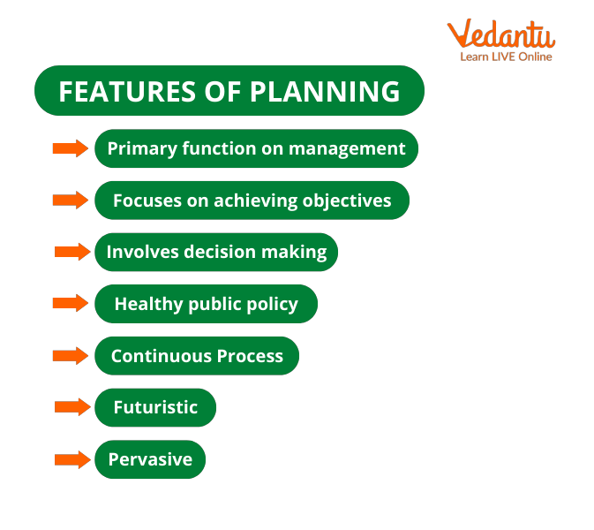
Chapter 3. Planning
Definition
Key Elements of Planning
Importance of Planning
Questions

Slide 7
Planning
Planning is a fundamental function of management that involves the process of setting goals, outlining strategies, and deciding on the actions needed to achieve those goals. It is like creating a roadmap for an organization, providing direction and purpose.

Slide 8
Important terms
Planning
Organization
Setting goals
Strategy
Market share
Resources
Risk assessment
Innovation ابتكار

Slide 9

Match the terms below to their explanations in the table.
Strategy | Planning | Resources
Organization | Market share | Innovation
The terms: | Their explanations:
 | It is the managerial function that involves the process of setting organizational goals, defining strategies to achieve those goals, and outlining the tasks and activities required for their accomplishment. It is a forward-looking process that helps organizations anticipate future challenges and opportunities, allowing them to develop a roadmap for success.
Planning

Slide 10
Match the terms below to their explanations in the table.
Strategy | Risk assessment | Resources
Organization | Market share | Innovation
The terms: | Their explanations:
 | It is a structured entity with a defined purpose, involving people working together to achieve common goals. They can take various forms, such as businesses, non-profit entities, government agencies, or educational institutions.
Organization

Slide 11
Match the terms below to their explanations in the table.
Strategy | Risk assessment | Resources
Organization | Market share | Innovation
The terms: | Their explanations:
 | It refers to a planned approach or a set of actions to achieve specific goals or objectives. In the business context, it involves choosing how resources will be allocated to achieve long-term success and competitive advantage.
Strategy

Slide 12
Match the terms below to their explanations in the table.
Strategy | Risk assessment | Resources
Organization | Market share | Innovation
The terms: | Their explanations:
 | It is the percentage of the total sales or revenue in a specific market that is captured by a particular company or product. It is a key indicator of a company's position and success relative to its competitors in each industry.
Market share

Slide 13
Match the terms below to their explanations in the table.
Strategy | Risk assessment | Resources
Organization | Market share | Innovation
The terms: | Their explanations:
 | They refer to the assets, both tangible and intangible, that an organization possesses and can use to achieve its objectives. These include financial capital, human capital (employees), physical assets, technology, and intellectual propertyالملكية الفكرية .
Resources

Slide 14
Match the terms below to their explanations in the table.
Strategy | Risk assessment | Resources
Organization | Market share | Innovation
The terms: | Their explanations:
 | It is the process of creating and implementing new ideas, products, processes, or methods that bring about positive change or improvement. It involves creativity ابداع , problem-solving, and a willingness to explore new and better ways of doing things.
Innovation

Slide 15
Match the terms below to their explanations in the table.
Strategy | Risk assessment | Resources
Organization | Market share | Innovation
The terms: | Their explanations:
 | It is the systematic process of evaluating potential risks or uncertainties that may impact an organization's objectives. It involves identifying, analyzing, and prioritizing risks to make informed مستنيرةdecisions on how to manage or mitigate يخفف them effectively.
Risk assessment

Slide 16
Key Elements of Planning
1. Setting Goals: Planning begins with establishing clear and specific objectives that the organization wants to achieve. These goals can be related to sales targets, market share, or any other aspect of the business.

Slide 17
Key Elements of Planning
2. Developing Strategies: Once the goals are set, managers need to figure out يكشف the best ways to reach them. This involves developing strategies, which are essentially plans of action outlining how to use resources effectively.

Slide 18
Key Elements of Planning
3. Determining Tasks and Activities: Breaking down the plan into specific tasks and activities is crucial. This includes deciding who will do what, when, and how. It's about assigning responsibilities and creating a timeline.

Slide 19
Key Elements of Planning
4. Allocating Resources: Planning also involves considering the resources needed to carry out the tasks. This includes human resources (employees), financial resources (budget), and physical resources (equipment and facilities المعدات والمرافق).

Slide 20
Key Elements of Planning
5. Risk Assessment: Effective planning includes anticipating potential challenges and risks. Managers must consider what could happen and develop strategies to handle those situations.

Slide 21

Importance of Planning
Provides Direction:
Planning sets a clear direction for the organization. It helps everyone understand what needs to be done and why.

Slide 22
Importance of Planning
2. Improves Efficiency:
By outlining tasks and allocating resources, planning contributes to the efficient use of time, money, and effort.

Slide 23
Importance of Planning
3. Facilitates Decision-Making: When plans are in place, decision-making becomes more straightforwardواضحة . Managers can refer to the plan when faced with choices.

Slide 24
Importance of Planning
4. Encourages Innovation: Through planning, organizations can foster a culture of innovation. It allows for creative thinking and finding new ways to achieve objectives.

Slide 25
Importance of Planning
5. Enhances Adaptability:
In a constantlyباستمرار changing business environment, planning helps organizations be more adaptable قابلة للتكيف. They can adjust strategies to respond to unforeseen غير متوقع circumstances.

Slide 26
Planning (summary)
In summary, planning is like a roadmap that guides an organization toward its goals. It involves setting objectives, developing strategies, assigning tasks, allocating resources, and considering potential risks. Effective planning is crucial for the success and adaptability of an organization in today's dynamic business environment.

Slide 27
Fill in the blanks with the most appropriate words from the table.
are | was | a | with
with
Setting Goals: Planning begins (1) ……… establishing clear and specific objectives that the organization wants to achieve. These goals can be related to sales targets, market share, or any other aspect of the business.
Developing Strategies: Once the goals are set, managers need to figure out يكشف the best ways to reach them. This involves developing strategies, which (2) ………. essentially plans of action outlining how to use resources effectively.
are

Slide 28
Answer the following essay questions:
1. Describe the role of setting goals in the planning process.
Answer:
Setting goals is the starting point of planning, involving the establishment of clear and specific objectives. Clear goals contribute to organizational success by providing a focused direction, guiding decision-making, and helping in resource allocation to achieve desired outcomes.

Slide 29
Answer the following essay questions:
2. Explain the importance of developing strategies in the planning process.
Answer:
Developing strategies in planning involves outlining plans of action to achieve set goals. Strategies are essential for effective resource utilization, guiding employees on how to reach objectives, and ensuring the organization's overall success.

Slide 30
Answer the following essay questions:
3. Discuss the significance of risk assessment in the planning process.
Answer:
Risk assessment is a vitalحيوي part of planning, involving the anticipation of potential challenges and developing strategies to handle them. Managers can foreseeتوقع challenges like market fluctuations and deviseيبتكر plans to mitigate these risks, ensuring the organization's resilienceمرونة .

Slide 31
Answer the following essay questions:
4. Illustrate how planning provides direction for an organization and contributes to improved efficiency.
Answer:
Planning provides direction by offering a clear roadmap for an organization. For instance, setting goals and outlining strategies guides employees on what needs to be done and why, contributing to improved efficiency. This clear direction benefits the organization by ensuring a focused effort and the efficient use of resources, ultimately أخيرًا leading to overall success.

